Slide 1
Foundation Class: Iterator
by Brandon Sheppard

Slide 2
Use of Iterator
Sequentially move through a collection
Can be very convenient
Phonebook example:
Phone number listings stored in a Linked List
Need to update area codes
No iterator
1 + 2 + 3 + … + n = n (n + 1) / 2 which is O( n²)
Iterator
1 + 1 + 1 + … + 1 = n which is O(n)
Efficiency increased by n times!

Slide 3

Iterator Interface
Iterator is useful and used a lot
Interface facilitates reuse
Creates a contract
Two implementation examples…

Slide 4
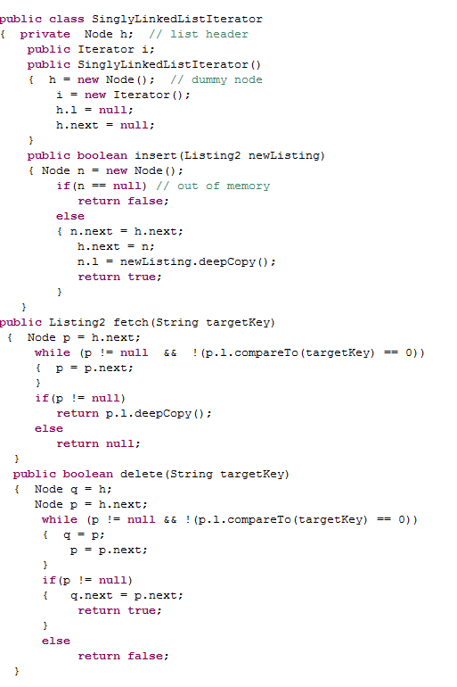
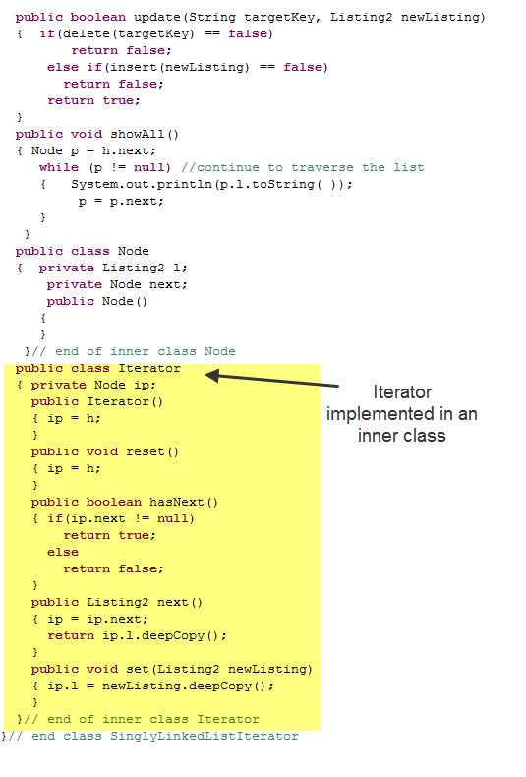
Inner Class Example

Slide 5
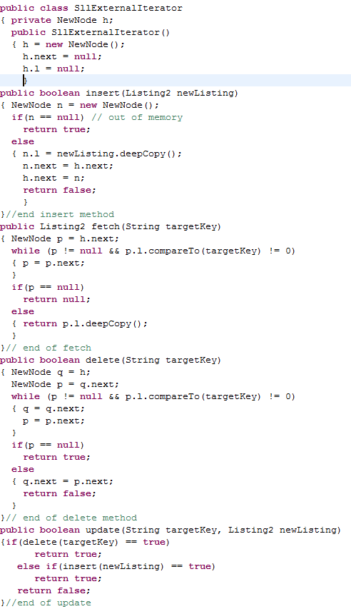
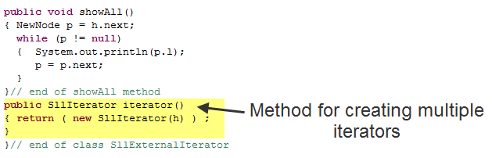
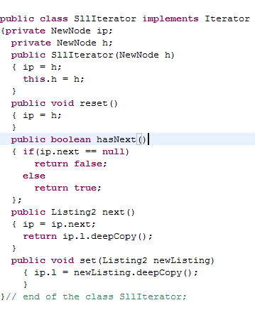
External Class Example

Slide 6
The END

